Slide 1
DSC 530: Exploratory Data Analysis Final Project - Samantha Rodriguez Professor Metzger

Slide 2

Statistical Question: How does stress level impact the duration and quality of sleep? Hypothesis: High Stress levels negatively impact Sleep Duration and Quality of Sleep.
Using the Five Variables below to complete this analysis:
Sleep Duration: Hours of sleep, describing a continuous variable
Quality of Sleep: Rating of sleep from a scale of 1-10, ordinal
Physical Activity Level: An indicator of activity frequency, ordinal
Stress Level: Scale of stress levels, ordinal
Age: Measured in years, continuous

Slide 3
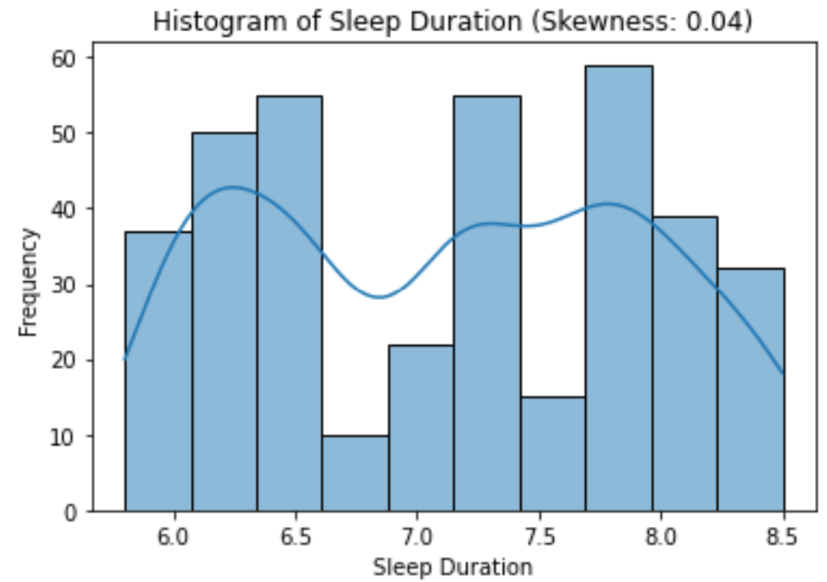
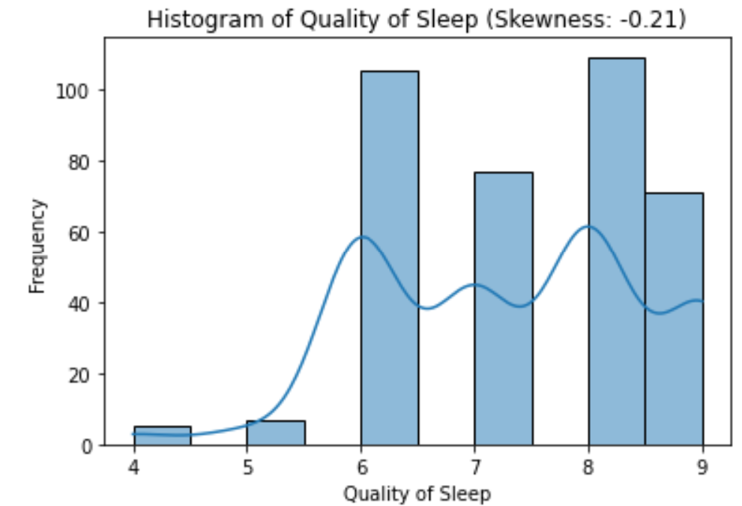
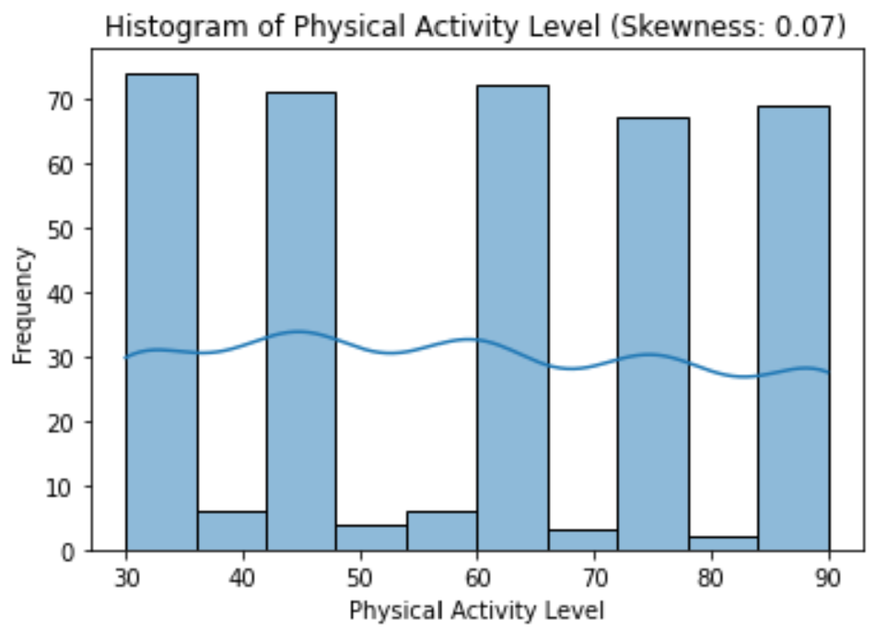
HISTOGRAMS – FIVE VARIABLES
Sleep Duration – skew is very close to 0 meaning there is a nearly symmetric distribution. Both shorter and longer durations are represented.
Quality of Sleep – skew is negative, shown to have a left skew as the tail is flatter to the left side. More observations or individuals reporting higher quality of sleep
Physical Activity Level – skew is close to 0, indicating a close to symmetrical distribution. Low, moderate, and high levels or activity are represented.

Slide 4
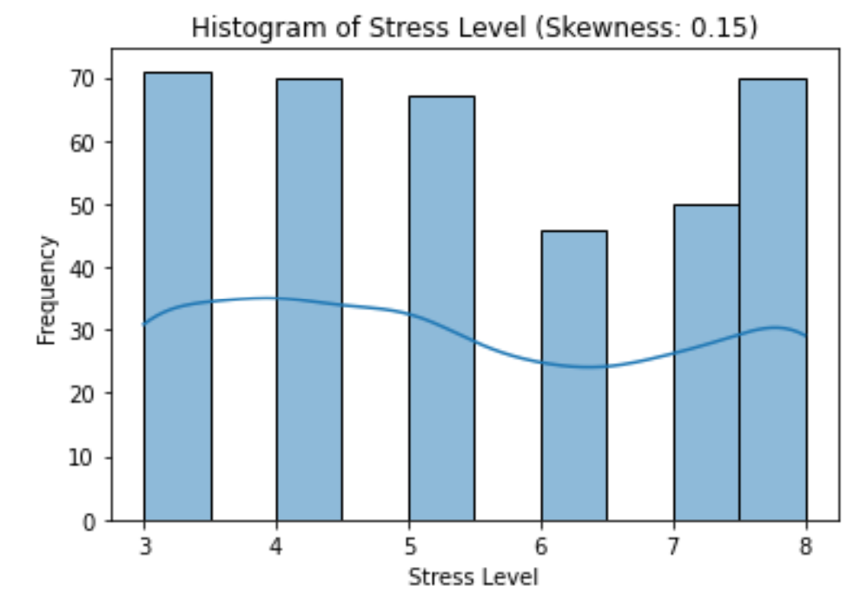
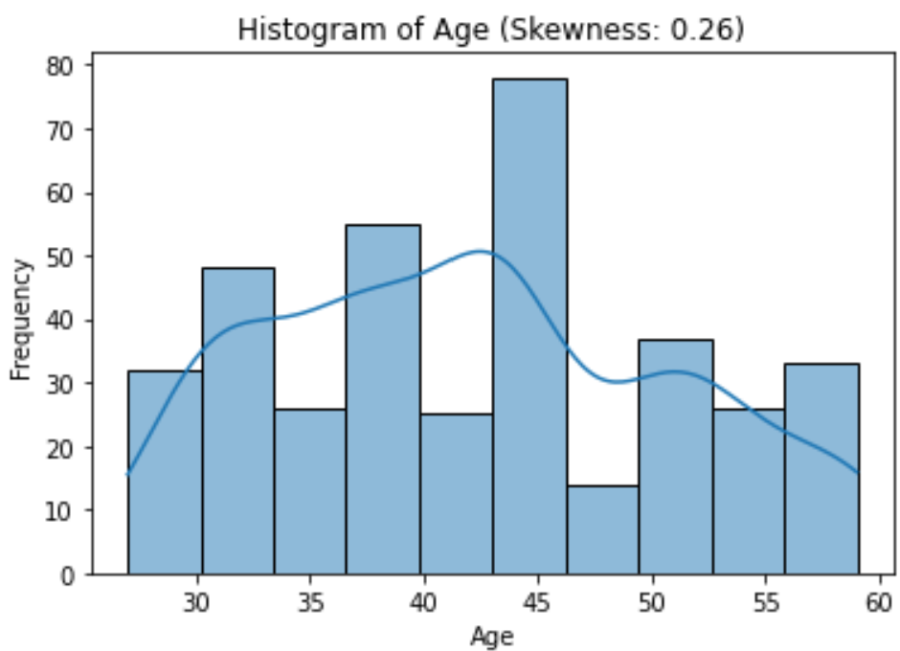
HISTOGRAMS – FIVE VARIABLES (CONT)
Stress Level – Seen is a slight skew to the right. This suggests that more observations are recorded to report low to moderate stress. However, there are individuals reporting higher stress.
Age – positive skew is showing a right skew. Individuals are younger in this particular data set. There are also more individuals in the middle age and there are fewer older individuals.

Slide 5
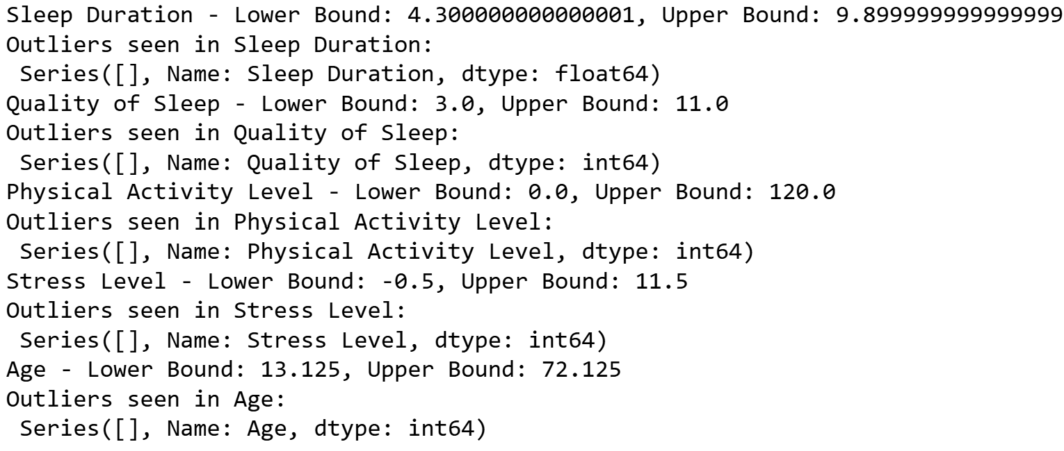
IDENTIFYING OUTLIERS
Although we do not see any extreme outliers when observing the histograms, we can validate once more using the IQR to identify any outliers within each variable.
We see that there are no major outlier concerns, they are within range.
Interquartile Range (IQR) to Identify Outliers

Slide 6
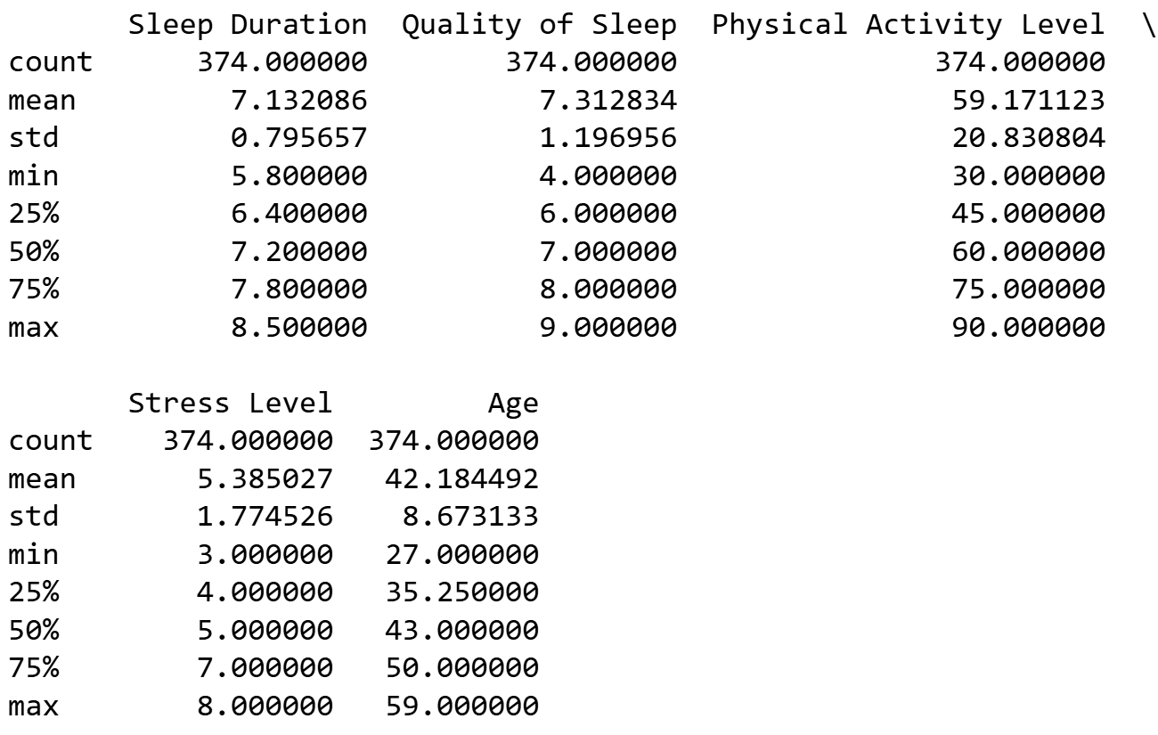
DESCRIPTIVE AND SUMMARY STATISTICS
Insights
Mean, Mode, Spread (Standard Deviation), and Tails (Min and Max):
We can further breakdown the nature of each variable.
Observe that 25% of individuals sleep less than 6.4 hours.
75% of people rate their sleep at an 8.
Physical activity is seen to be distributed fairly.
75% of people rate their stress level at 7 or below
Age is seen to be concentrated in middle aged population.

Slide 7
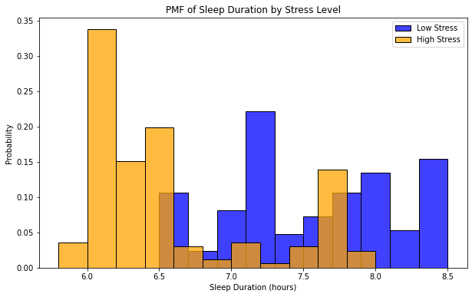
PMF – Sleep Duration by Stress Level
Insights
Each bar is representing the probability of individuals reporting specific ranges of duration. We can now observe if stress impacts sleep length.
Low stress has a peak near the mid to high range of sleep duration. This means to suggest lower stress is likely to equate to better sleep.
High stress is leaning to lower sleep durations.
Low stress furthermore displays that 7-8 hours of sleep is achieved.
Blue: Represents individuals with stress levels at/below the median.
Orange: Represents individuals with stress levels above the median.

Slide 8
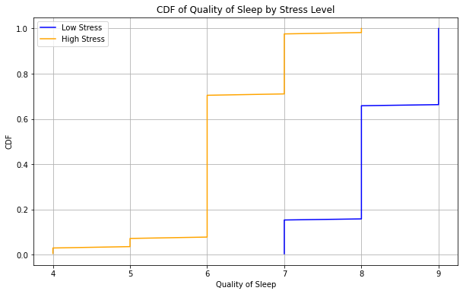
CDF – QUALITY OF SLEEP by Stress Level
Insights
Using the same calculation with the median we can now observe how stress levels effect the quality of sleep.
High stress is shown to suggest that individuals will report lower quality of sleep.
While low stress individuals reports higher quality.
Furthermore, this drives the point at how stress level affect both sleep duration and quality of sleep.
Blue: Represents individuals with stress levels at/below the median.
Orange: Represents individuals with stress levels above the median.

Slide 9
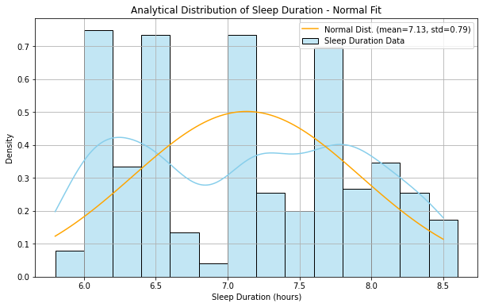
Analytical Distribution – Sleep duration
Insights
The histogram will show us the frequency and how sleep duration is spread across the sample.
The KDE line (blue) further shows the serration of the bins.
Due to the multimodal shape of the data, there are different groups seen with peaks around 6, 7, 7.5 hours.
Due to the multiple peaks, the data is not perfectly aligned with the fitted normal distribution.
Sleep durations are more likely to be affected by underlying factors of stress level, age, or physical activity.
Sleep Duration Data: Seen to fit a multimodal view with three peaks.
Orange Curve: Represents normal distribution based on the mean and standard deviation. Concentrated between 6.5-7 hours.

Slide 10
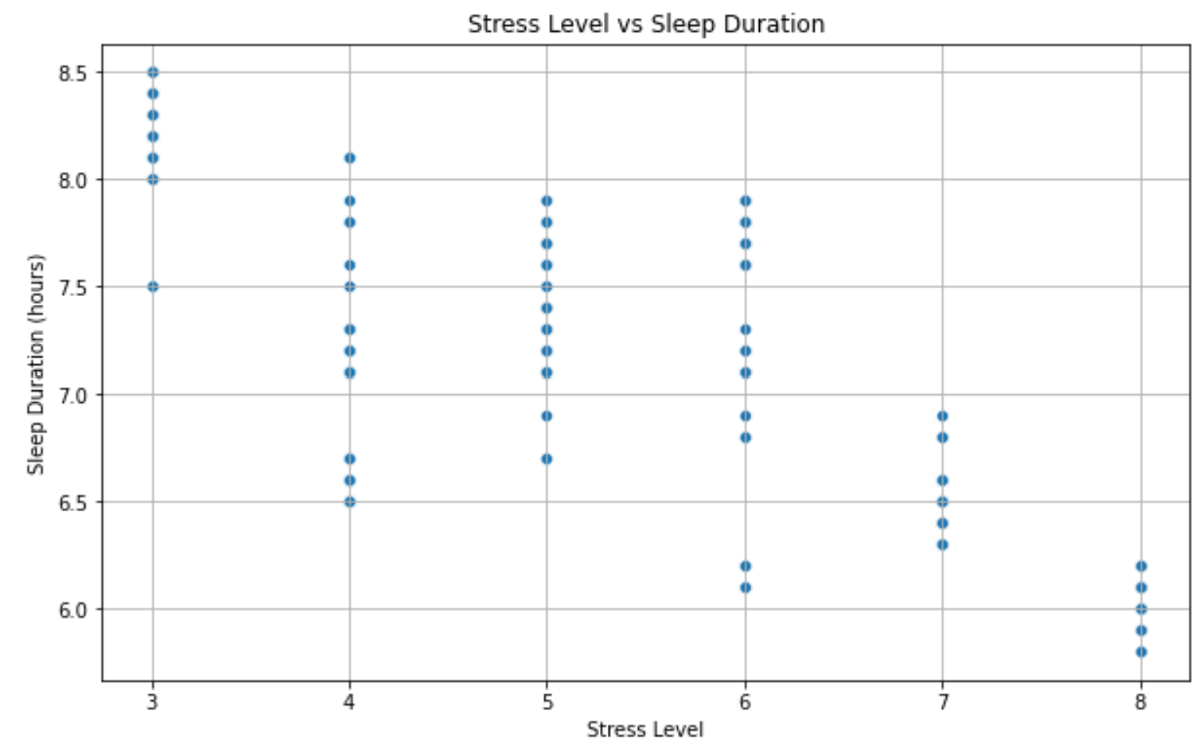
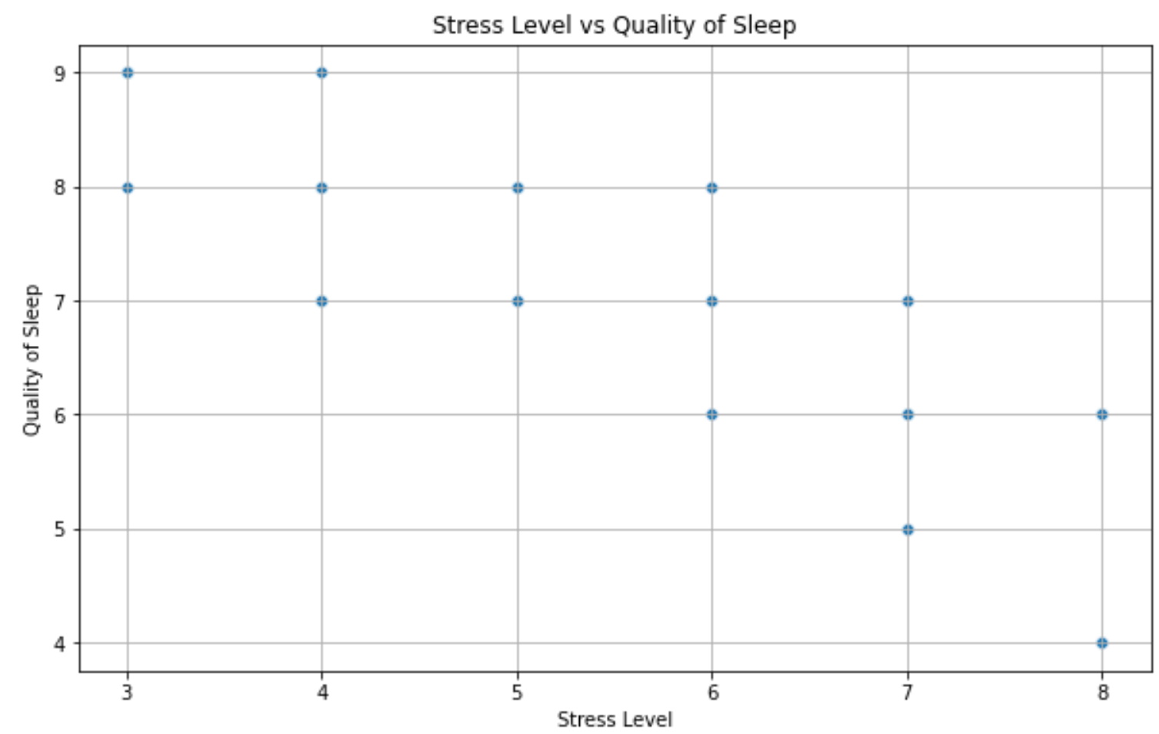
Scatter plots – correlation & Causation
Pearson’s Correlation: -0.8110 | Covariance: -1.1450
Pearson’s Correlation: -0.89875 | Covariance: -1.9089762
Observe, when plotting these two variables using a scatter plot we see a downward trend as Sleep Duration decreases when Stress Levels increase.
The same can be said in this scenario, we see a downward trend as Quality of Sleep decreases when Stress Levels increase.
Pearson’s Correlation: We see a strong negative relationship, within the range of -1 < r < -0.7
Covariance: We see a negative covariance (direction) as stress level increases, sleep duration decreases
Pearson’s Correlation: We can also see a strong negative relationship, within the range of -1 < r < -0.7
Covariance: We see a negative covariance (direction) as stress level increases, quality of sleep decreases

Slide 11
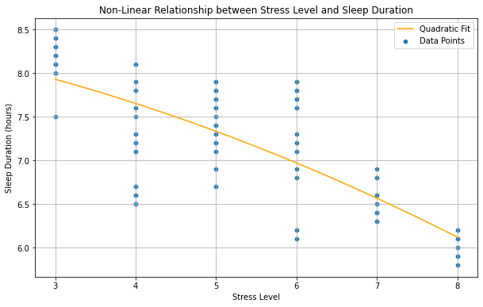
Nonlinear Relationships – Polynomial REGRESSION
Insights
Adding the Quadratic fit, we observe yet the line is trending downward. This indicates still as stress levels increase, sleep duration will decrease.
Although it’s relatively still linear, the subtle curve gives a more accurate picture of the nature of the relationship. It seems to further support the hypothesis.

Slide 12
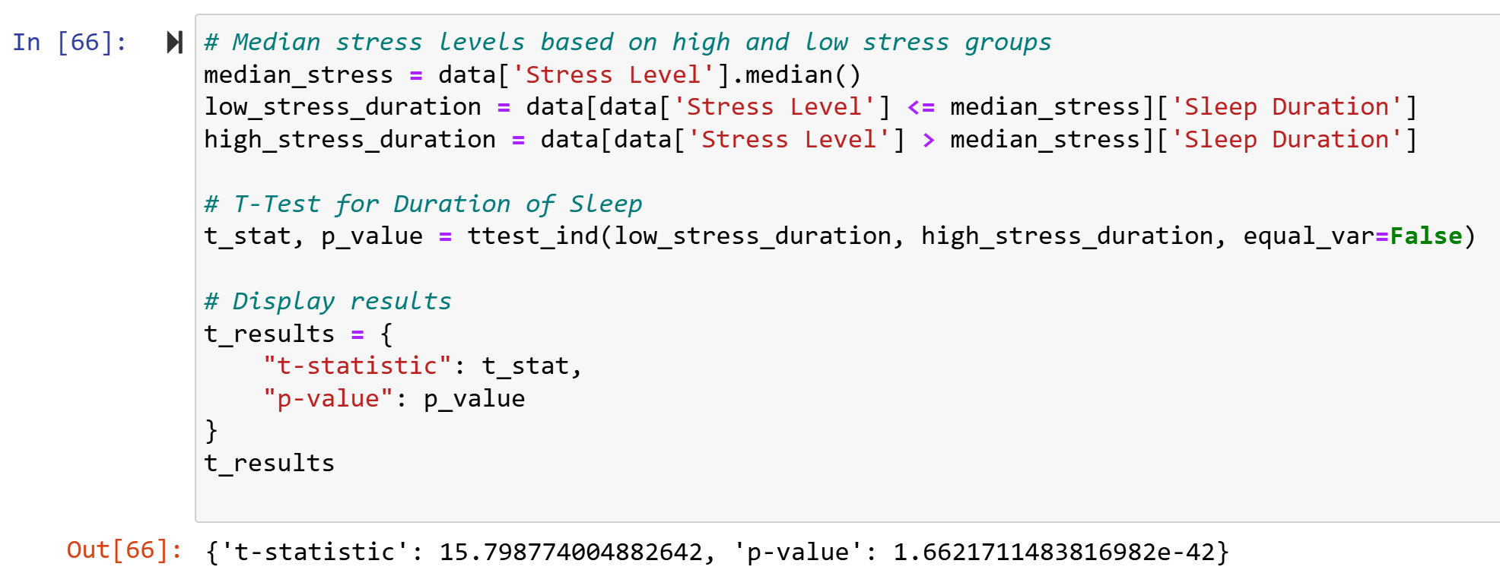
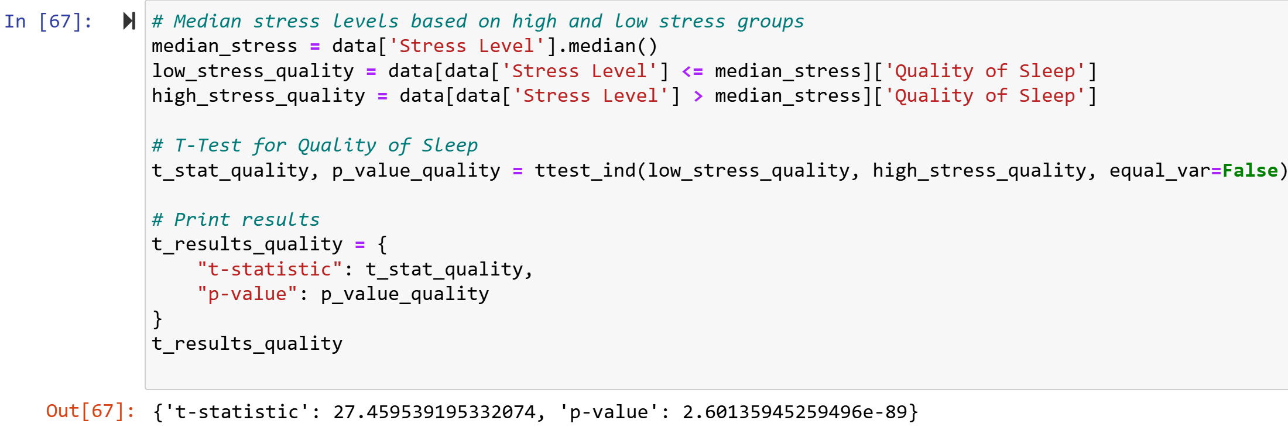
Hypothesis Testing – T-Statistic and P-Values
Stress Levels vs Sleep Duration
T-Statistic: The t-statistic value is high, meaning the difference is likely to be statistically significant
P-Value: Since it is greater than 0.05, this suggests that differences between sleep duration and stress level are NOT statistically significant, due to random chance
Stress Levels vs Quality of Sleep
T-Statistic: The value is even higher for this comparison, likely to find statistical significance
P-Value: Even greater than 0.05 implying differences in quality of sleep between respondents with low or high stress levels are not strong or consistent

Slide 13
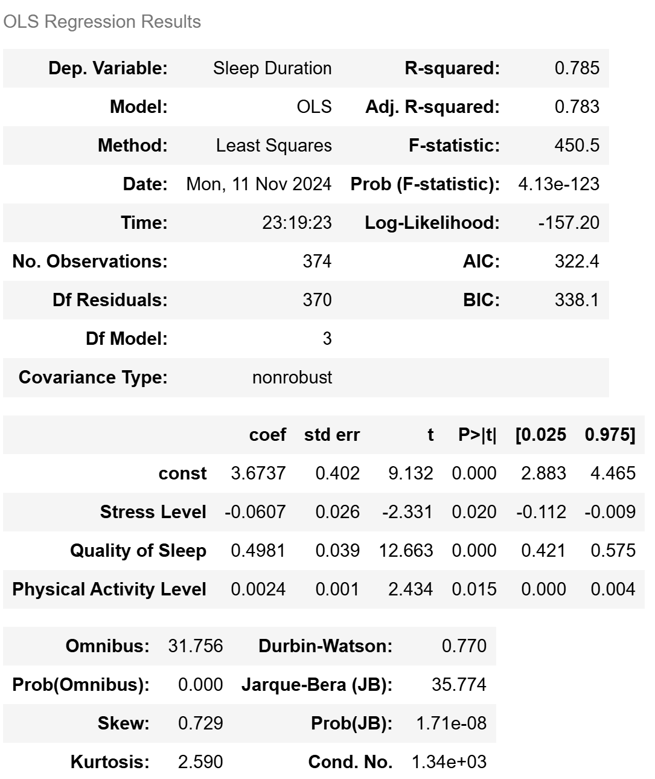
Multiple Regression Analysis (OLS)
Dependent: Sleep Duration | Independent Variables: Stress Levels, Quality of Sleep, Physical Activity Level
Insights
The R-Squared Value indicated 78.5% of Variance in sleep duration that can be explained by the model. This is a good fit.
The F-statistic indicated the model is statistically significant.
Here we observe, a negative coefficient value for Stress Level. Further implying a negative relationship.
Quality of Sleep and Physical Activity coefficient values are positive, entailing a positive relationship. Higher levels of physical activity are attributed to longer duration of sleep.
Taking note however of the Skew and Kurtosis values, the residuals are not perfectly normal which may indicate underlying outliers or model specification issues.
The model seems to observe quality of sleep is the ultimate predictor of sleep duration compared to the other variables.

